Slide 1
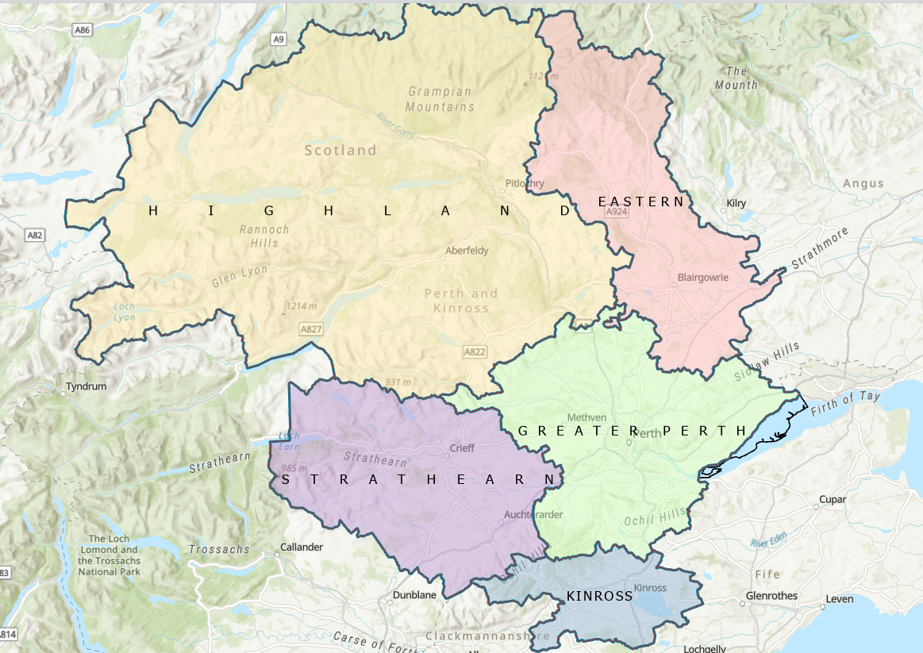

© Crown copyright and database rights 2026 OS AC0000805756. You are permitted to use this data solely to enable you to respond to, or interact with, the organisation that provided you with the data. You are not permitted to copy, sub-licence, distribute or sell any of this data to parties in any form.

